Slide 1
Introduction to Data
Lesson 1.1

Slide 3
The Rise of Data

Slide 4
Why is data analytics such a hot skill these days?

Slide 5

Explosive Growth in Digitized Data (Creation)
1

Slide 6

Explosive Growth in Analytic Tools (Synthesis)
2

Slide 7
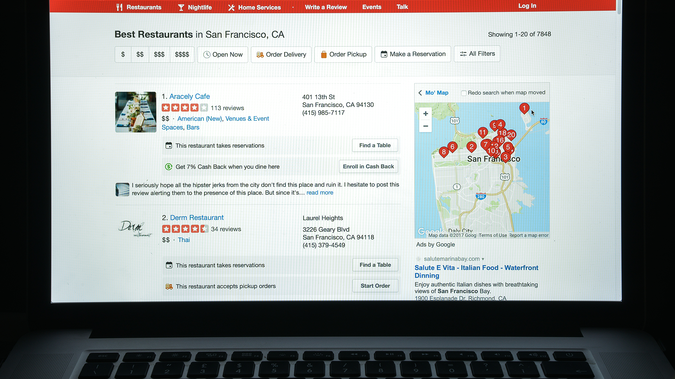
Accelerating Search for Actionable Insight (Value)
3

Slide 8
What does the term data science mean?

Slide 9

Perhaps you are picturing an Excel spreadsheet.

Slide 10

Data Science Involves Spreadsheets and Formulas

Slide 11
Fundamentally, data science is about storytelling and truth-telling.

Slide 12
Data as Storytelling

Slide 13
Data as Storytelling
U.S. Debt as Percentage of Gross Domestic Product, 1790–2011
1790 | 29,6% | 1835 | 0.0 | 1880 | 18.4 | 1925 | 21.6 |  | 1970 | 28.0
1791 | 29.2 | 1836 | 0,0 | 1881 | 16.8 | 1926 | 19.0 |  | 1971 | 28.1
1792 | 28.0 | 1837 | 0.2 | 1882 | 14.3 | 1927 | 18.0 |  | 1972 | 27.4
1793 | 24.4 | 1838 | 0.6 | 1883 | 13.5 | 1928 | 17.0 |  | 1973 | 26.0
1794 | 21.8 | 1839 | 0.2 | 1884 | 13.3 | 1929 | 14.9 |  | 1974 | 23.9
1795 | 18.7 | 1840 | 0.3 | 1885 | 13.2 | 1930 | 16.5 |  | 1975 | 25.3
1796 | 16.4 | 1841 | 0.8 | 1886 | 12.4 | 1931 | 22.3 |  | 1976 | 27.5
1797 | 16.5 | 1842 | 1.2 | 1887 | 11.2 | 1932 | 34.5 |  | 1977 | 27.8
1798 | 16.0 | 1843 | 1.5 | 1888 | 10.2 | 1933 | 39.1 |  | 1978 | 27.4
1799 | 15.8 | 1844 | 1.0 | 1889 | 8.6 | 1934 | 44.0 |  | 1979 | 25.6
1800 | 15.1 | 1845 | 0.7 | 1890 | 7.8 | 1935 | 42.9 |  | 1980 | 26.1
1801 | 13.3 | 1846 | 1.2 | 1891 | 7.0 | 1936 | 43.0 |  | 1981 | 25.8
1802 | 13.9 | 1847 | 1.7 | 1892 | 6.6 | 1937 | 40.1 |  | 1982 | 28.7
1803 | 14.1 | 1848 | 2.2 | 1893 | 6.8 | 1938 | 42.8 |  | 1983 | 33.1
1804 | 13.2 | 1849 | 2.5 | 1894 | 7.9 | 1939 | 43.0 |  | 1984 | 34.0
1805 | 10.9 | 1850 | 2.3 | 1895 | 7.9 | 1940 | 42.7 |  | 1985 | 26.4
1806 | 10.0 | 1851 | 2.4 | 1896 | 8.5 | 1941 | 43.3 |  | 1986 | 38.5
The Great Depression & World War II
Reagan Tax Cuts
Data: Congressional Budget Office

Slide 14
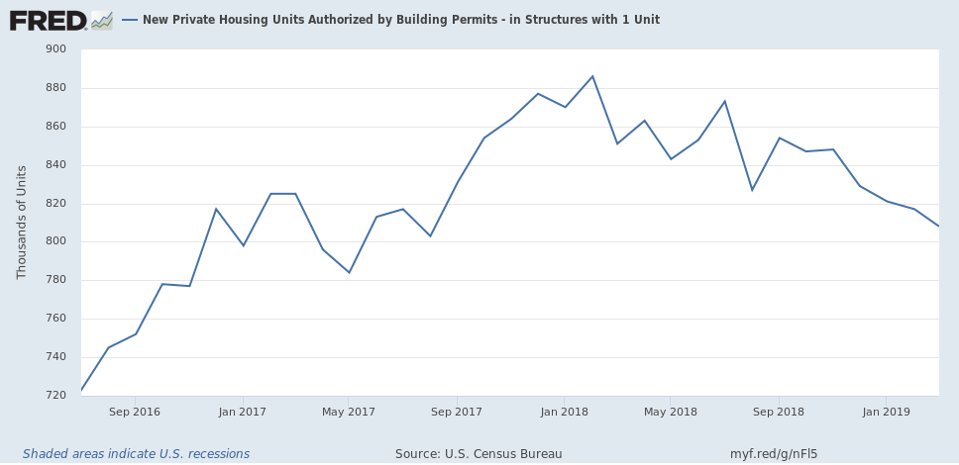
Data = Drama
New Housing Construction: Making A Bottom, At Close To Recessionary Levels
https://seekingalpha.com

Slide 15
Data as Truth-Telling

Slide 16
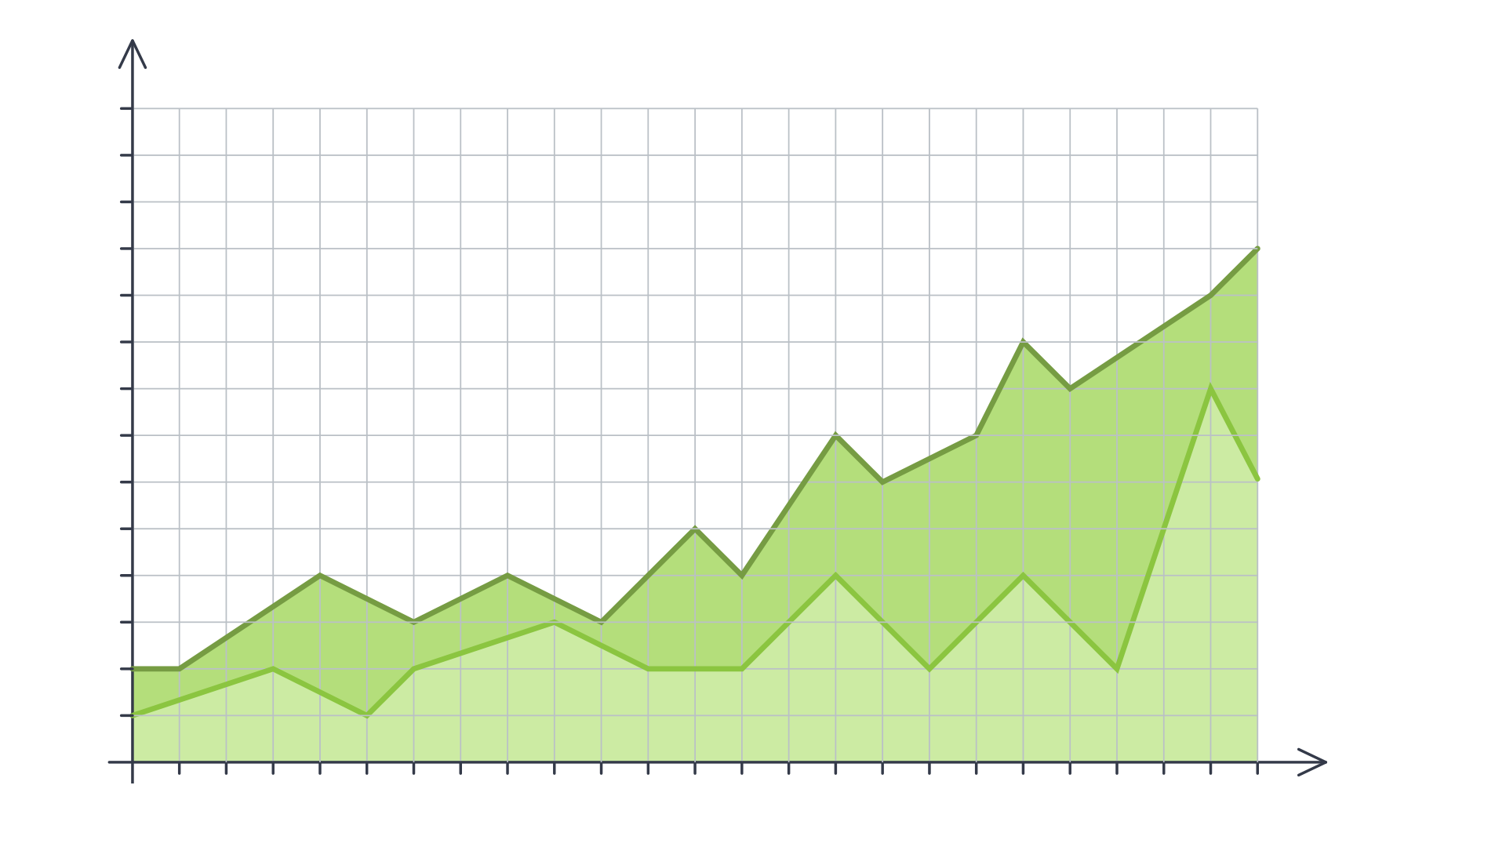


Data as Truth-Telling
Unearthing Relationships
Lung Cancer Deaths per 100,000
100k
95k
80k
85k
80k
75k
70k
65k
60k
55k
50k
45k
40k
35k
30k
25k
20k
1900
1901
1902
1903
1904
1905
1906
1907
1908
1909
1909
1910
1911
1912
1913
1914
1915
1916
1917
1918
1919
1920
Lung Cancer Deaths
Cigarettes Smoked

Slide 17

Data as Truth-Telling
Making Predictions

Slide 18
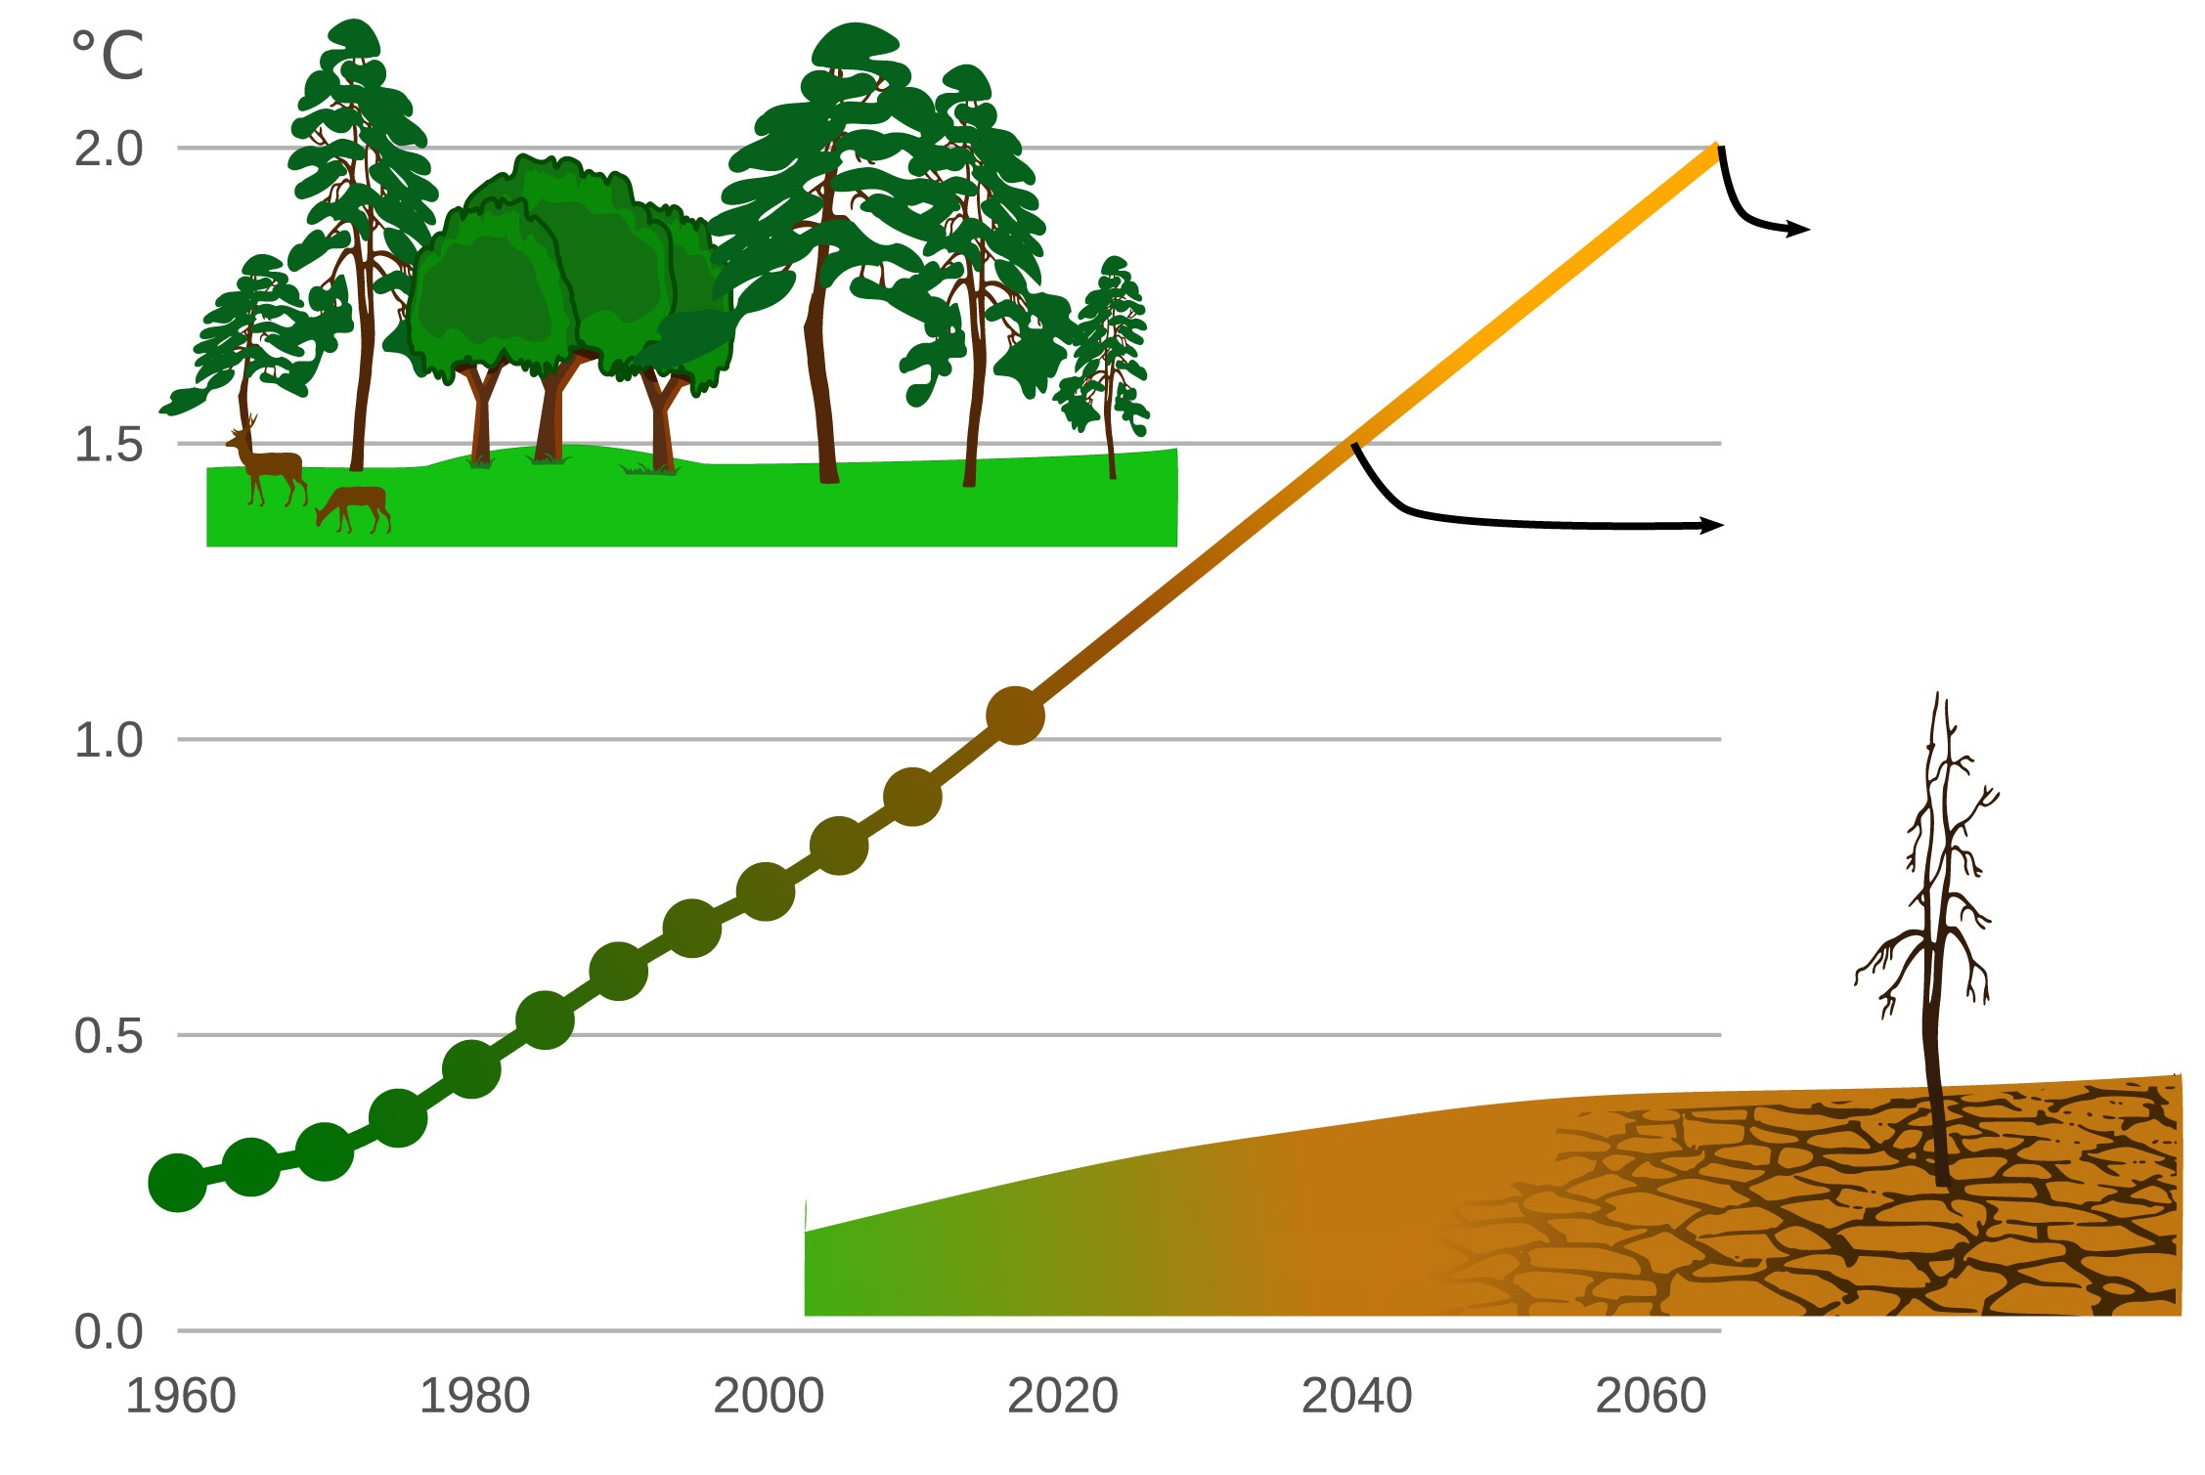
Data as Truth-Telling
Stating Significance
Exposure to Extreme Drought Is Increasing
190 million people
114 million people
Image Source: Exposure to Extreme Drought is Increasing

Slide 19
Course Overview

Slide 20



Tools for Truths, Skills for Stories:
Our Goals:
Our Means:
Microsoft Excel
Python
pandas
Matplotlib/Seaborn
APIs
Beautiful Soup
Machine Learning
SQL
MongoDB
HTML/CSS
JavaScript
D3.js
Leaflet.js/Google Maps
Tableau
Hadoop
Truth-telling
Storytelling

Slide 21
Course Overview
Each class will include the following:
Overview of Lesson Topics
Instructor Lecture
Instructor Demonstration
Class Discussions
In-Class Activities
Project Work

Slide 22
Weekly Breakdown by Subject

Slide 23
Weeks 1–2
Intro to Data Analytics & Excel Masters: Introduction to the high-level concepts of data analytics and real-world data crunching with Excel formulas, pivot tables, and conditional formatting.
Week 1
Week 2
Week 3
Week 4
Week 5
Week 6
Week 7
Week 8
Week 9
Week 10
Week 11
Week 12
Week 13
Week 14
Week 15
Week 16
Week 17
Week 18
Week 19
Week 20
Week 21
Week 22
Week 23
Week 24
Python Data Analytics and Visualization: Thorough crash course on Python programming, followed by multiple weeks of data processing using advanced libraries like NumPy, pandas, Matplotlib, Seaborn, and Beautiful Soup.
Deep Dive into Databases: Immersion into introductory and advanced work with SQL (PostgreSQL) and noSQL databases (MongoDB).
Web-Based Data Visualization: Introduction to the fundamental tools of web development (HTML, CSS, JavaScript) and advanced libraries that are useful for data visualization (D3.js, Leaflet.js), and R.
Final Projects & Advanced Topics: Introduction to Tableau and advanced topics like Hadoop and Machine Learning. Develop a real-world data visualization project.

Slide 24
Weeks 3–8
Week 1
Week 2
Week 3
Week 4
Week 5
Week 6
Week 7
Week 8
Week 9
Week 10
Week 11
Week 12
Week 13
Week 14
Week 15
Week 16
Week 17
Week 18
Week 19
Week 20
Week 21
Week 22
Week 23
Week 24
Intro to Data Analytics & Excel Masters: Introduction to the high-level concepts of data analytics and real-world data crunching with Excel formulas, pivot tables, and conditional formatting.
Python Data Analytics and Visualization: Thorough crash course on Python programming, followed by multiple weeks of data processing using advanced libraries like NumPy, pandas, Matplotlib, Seaborn, and Beautiful Soup.
Deep Dive into Databases: Immersion into introductory and advanced work with SQL (PostgreSQL) and noSQL databases (MongoDB).
Web-Based Data Visualization: Introduction to the fundamental tools of web development (HTML, CSS, JavaScript) and advanced libraries that are useful for data visualization (D3.js, Leaflet.js), and R.
Final Projects & Advanced Topics: Introduction to Tableau and advanced topics like Hadoop and Machine Learning. Develop a real-world data visualization project.

Slide 25
Weeks 9–13
Week 1
Week 2
Week 3
Week 4
Week 5
Week 6
Week 7
Week 8
Week 9
Week 10
Week 11
Week 12
Week 13
Week 14
Week 15
Week 16
Week 17
Week 18
Week 19
Week 20
Week 21
Week 22
Week 23
Week 24
Intro to Data Analytics & Excel Masters: Introduction to the high-level concepts of data analytics and real-world data crunching with Excel formulas, pivot tables, and conditional formatting.
Python Data Analytics and Visualization: Thorough crash course on Python programming, followed by multiple weeks of data processing using advanced libraries like NumPy, pandas, Matplotlib, Seaborn, and Beautiful Soup.
Deep Dive into Databases: Immersion into introductory and advanced work with SQL (PostgreSQL) and noSQL databases (MongoDB).
Web-Based Data Visualization: Introduction to the fundamental tools of web development (HTML, CSS, JavaScript) and advanced libraries that are useful for data visualization (D3.js, Leaflet.js), and R.
Final Projects & Advanced Topics: Introduction to Tableau and advanced topics like Hadoop and Machine Learning. Develop a real-world data visualization project.

Slide 26
Weeks 14–17
Week 1
Week 2
Week 3
Week 4
Week 5
Week 6
Week 7
Week 8
Week 9
Week 10
Week 11
Week 12
Week 13
Week 14
Week 15
Week 16
Week 17
Week 18
Week 19
Week 20
Week 21
Week 22
Week 23
Week 24
Intro to Data Analytics & Excel Masters: Introduction to the high-level concepts of data analytics and real-world data crunching with Excel formulas, pivot tables, and conditional formatting.
Python Data Analytics and Visualization: Thorough crash course on Python programming, followed by multiple weeks of data processing using advanced libraries like NumPy, pandas, Matplotlib, Seaborn, and Beautiful Soup.
Deep Dive into Databases: Immersion into introductory and advanced work with SQL (PostgreSQL) and noSQL databases (MongoDB).
Web-Based Data Visualization: Introduction to the fundamental tools of web development (HTML, CSS, JavaScript) and advanced libraries that are useful for data visualization (D3.js, Leaflet.js), and R.
Final Projects & Advanced Topics: Introduction to Tableau and advanced topics like Hadoop and Machine Learning. Develop a real-world data visualization project.

Slide 27
Weeks 18–24
Week 1
Week 2
Week 3
Week 4
Week 5
Week 6
Week 7
Week 8
Week 9
Week 10
Week 11
Week 12
Week 13
Week 14
Week 15
Week 16
Week 17
Week 18
Week 19
Week 20
Week 21
Week 22
Week 23
Week 24
Intro to Data Analytics & Excel Masters: Introduction to the high-level concepts of data analytics and real-world data crunching with Excel formulas, pivot tables, and conditional formatting.
Python Data Analytics and Visualization: Thorough crash course on Python programming, followed by multiple weeks of data processing using advanced libraries like NumPy, pandas, Matplotlib, Seaborn, and Beautiful Soup.
Deep Dive into Databases: Immersion into introductory and advanced work with SQL (PostgreSQL) and noSQL databases (MongoDB).
Web-Based Data Visualization: Introduction to the fundamental tools of web development (HTML, CSS, JavaScript) and advanced libraries that are useful for data visualization (D3.js, Leaflet.js), and R.
Final Projects & Advanced Topics: Introduction to Tableau and advanced topics like Hadoop and Machine Learning. Develop a real-world data visualization project.

Slide 28
Example Activity

Slide 29
Example Activity: Banking Deserts
In this activity, you will use a variety of public demographic data and APIs to explain many real-world social phenomena. Utilize data from sources like the U.S. Census, Google Maps, and more to find insights on poverty, discrimination, and the impact of changing economies.
20 minutes

Slide 30
Projects

Slide 31
Projects
Week 1
Week 2
Week 3
Week 4
Week 5
Week 6
Week 7
Week 8
Week 9
Week 10
Week 11
Week 12
Week 13
Week 14
Week 15
Week 16
Week 17
Week 18
Week 19
Week 20
Week 21
Week 22
Week 23
Week 24
Project Specialization Tracks
Tackle each project with a specialized track!
Choose your focus:
Project 1: Exploratory Data Analysis
Project 2: Extract, Transform & Load
Finance
Healthcare
Custom
Project 3: Data Visualizations
Final Project: Machine Learning

Slide 32
Helpful Tips

Slide 33

Embrace your inner toddler.

Slide 34

Brace yourself for doubt, challenge, and confusion.

Slide 35

There is no shortcut.
You’ve got to put in the hours!
Notes:
shutterstock_643629568

Slide 36

Form a community with your classmates.

Slide 37

Enjoy the novice experience and expect a lot of lightbulb moments.

Slide 38

Celebrate your successes!

Slide 39
Group Activity:
Form groups of 3 or 4 people. Introduce yourself to your group.
Get up from your seats and walk around.
Don’t be shy!
10 minutes

Slide 41
Group Activity: The Great Debate
Find the group you formed before the break. Together, ponder the following question.
20 minutes

Slide 42
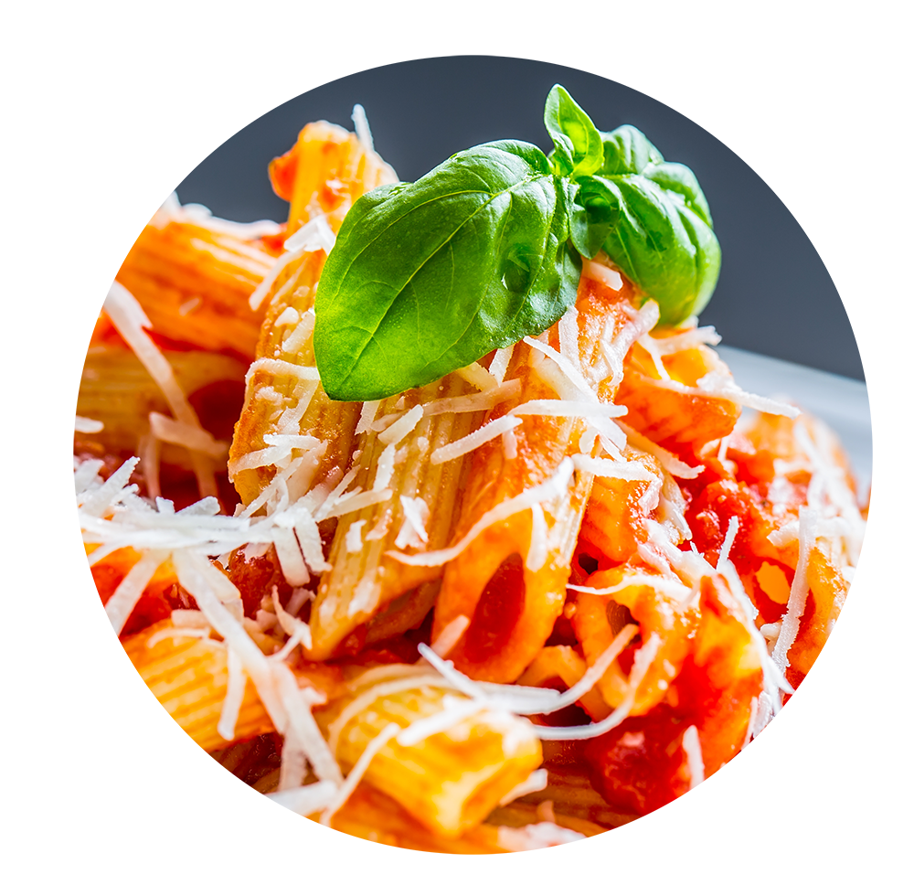
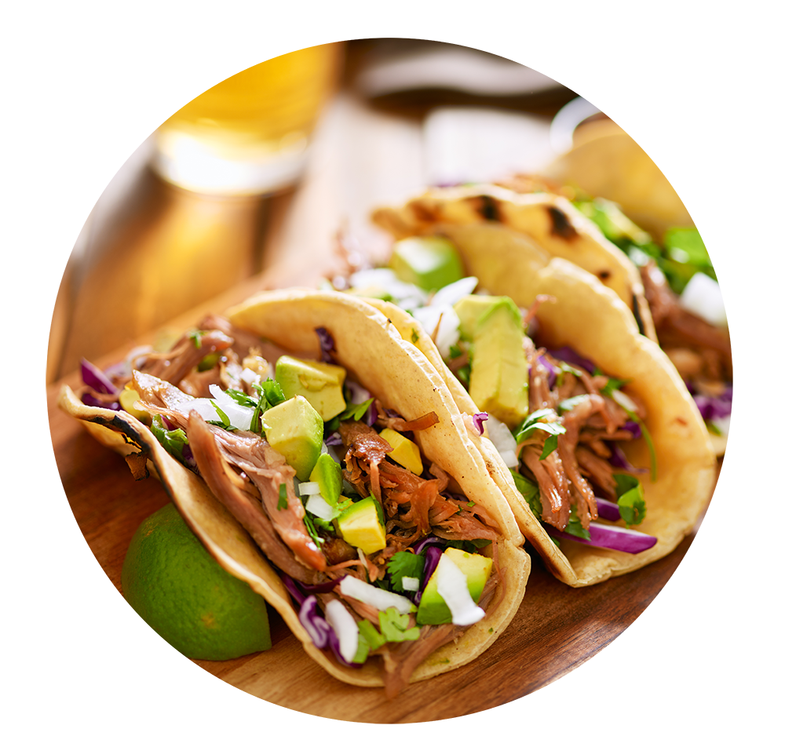
Group Activity: The Great Debate
Which food do Americans prefer:
Italian or Mexican food?

Slide 43
Group Activity: The Great Debate
With your group, develop a strategy for answering this question with as much confidence possible. Specifically, answer questions like:
Assumptions:
What data will you attempt to gather?
What relationships will you be looking for?
How will you ensure your answer is most likely “true”?
You are given 5 hours and a budget of $10 to accomplish this.
Your answer will be tested by randomly selecting 9 Americans who will each be asked the question—with 0 qualifiers.
You only have your team.

Slide 44
The Great Debate (Analyzed)

Slide 45
Step 1: Decompose the “Ask”

Slide 46
Step 1: Decompose the “Ask”
Which food do Americans prefer:
Italian or Mexican food?

Slide 47
Step 1: Decompose the “Ask”
Which food do Americans prefer: Italian or Mexican food?
Who exactly is an American?
Are Americans just homeowners?
Do Americans just live in big cities?
Are Americans just millennials?

Slide 48
How can we get a representative sample of Americans?

Slide 49
Step 1: Decompose the “Ask”
Which do Americans prefer:
Italian or Mexican food?

Slide 50
Step 1: Decompose the “Ask”
Which do Americans prefer: Italian or Mexican food?
How do we define “preference”?
Do people prefer the foods they eat most frequently?
Do people prefer the foods they wish they could eat if cost was not an issue?
How uniform is the preference? Is it regionalized? Is it different by demographic?

Slide 51
Inherently, preference is subjective. We are going to need to make it objective.

Slide 52
Step 1: Decompose the “Ask”
Which do Americans prefer:
Italian or Mexican food?

Slide 53
Italian and Mexican are broad categories to pursue. We will have to narrow the scope.

Slide 54
Step 1: Decompose the “Ask”
Which food do Americans prefer: Italian or Mexican food?
01
02
03
How do we categorize foods? Is pizza Italian? Is Taco Bell Mexican?
How do we categorize food? Does making pasta at home constitute Italian? Or are we just talking about restaurants?
Are we just talking about “best experiences”? Or are we including poorer versions of these foods?

Slide 55
Step 2: Identify Data Sources

Slide 56









Step 2: Identify Data Sources
Why poll an audience when there are already enormous databases of information about Americans’ food preferences—readily available online?

Slide 57
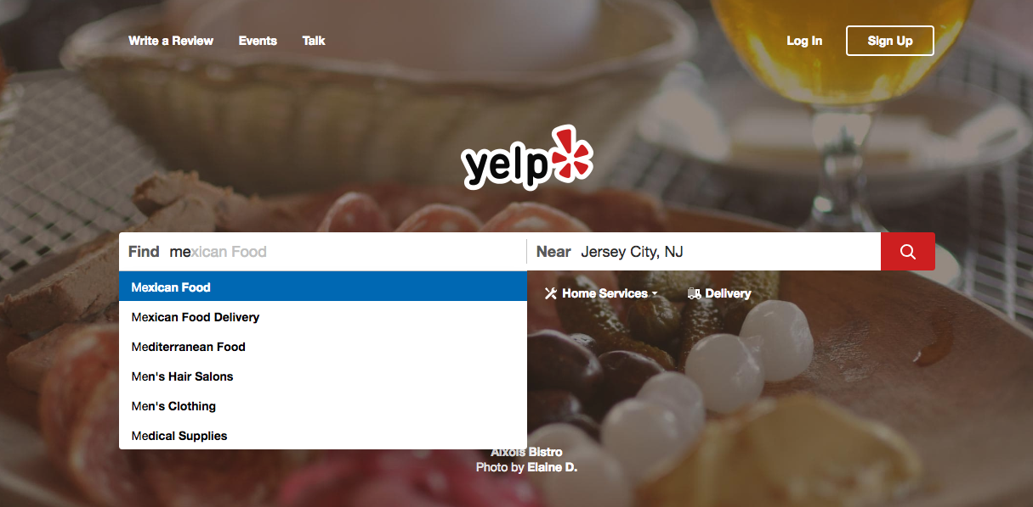
Step 2: Identify Data Sources
As everyday consumers, we are regularly getting a pulse of everyday American food preferences to inform our own decisions. Perhaps we can make use of the same approach.
www.yelp.com

Slide 58
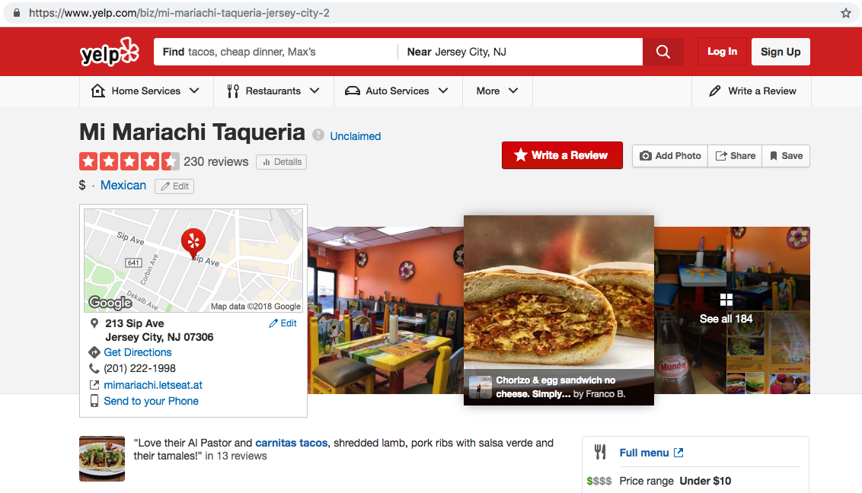
Step 2a: Identify Data Sources
Web services like Yelp provide an almost-encyclopedic amount of information about the eating preferences of Americans.
www.yelp.com

Slide 59
Step 3: Define Strategy and Metrics

Slide 60
Step 3: Define Strategy and Metrics
Here, we created a blueprint for what we’re targeting:
Americans | Ideally, we need thousands of records from Americans in hundreds of cities. (Large samples)
Preference | Number of Yelp reviews (More = Preference) Average aggregated ratings (Higher = Preference)
Italian and Mexican Food | Top-20 Italian restaurants and top-20 Mexican restaurants in every city

Slide 61
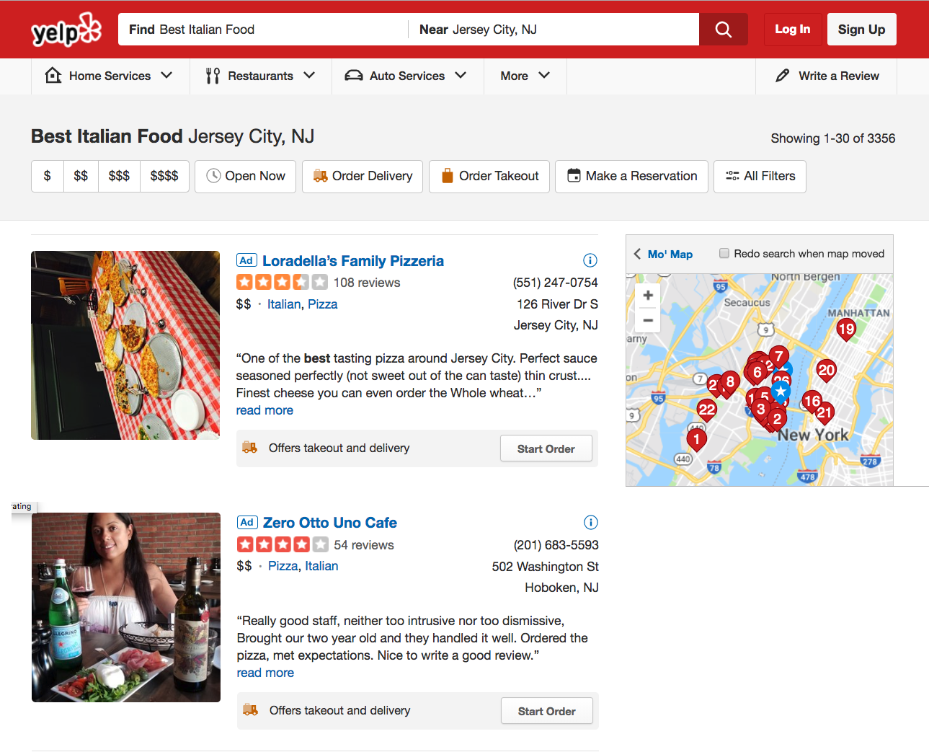

Step 3: Define Strategy and Metrics
Food Type
Lots of Data!
Review Count
Locations
Rating
www.yelp.com

Slide 62
Step 3: Define Strategy and Metrics
Repeat this analysis for as many cities as possible.
New York, NY
Italian | Mexican
Restaurant | Restaurant
Restaurant | Restaurant
Restaurant | Restaurant
Restaurant | Restaurant
Restaurant | Restaurant
Tucson, AZ
Italian | Mexican
Restaurant | Restaurant
Restaurant | Restaurant
Restaurant | Restaurant
Restaurant | Restaurant
Restaurant | Restaurant
Washington, D.C.
Italian | Mexican
Restaurant | Restaurant
Restaurant | Restaurant
Restaurant | Restaurant
Restaurant | Restaurant
Restaurant | Restaurant
VS.
VS.
VS.
Omaha, NE
Italian | Mexican
Restaurant | Restaurant
Restaurant | Restaurant
Restaurant | Restaurant
Restaurant | Restaurant
Restaurant | Restaurant
San Diego, CA
Italian | Mexican
Restaurant | Restaurant
Restaurant | Restaurant
Restaurant | Restaurant
Restaurant | Restaurant
Restaurant | Restaurant
Atlanta, GA
Italian | Mexican
Restaurant | Restaurant
Restaurant | Restaurant
Restaurant | Restaurant
Restaurant | Restaurant
Restaurant | Restaurant
VS.
VS.
VS.

Slide 63
Step 4: Build Data Retrieval Plan

Slide 64
Step 4: Build Data Retrieval Plan
We could retrieve this data by brute force, but it would be:
Extremely time-consuming
Skewed by our city familiarity
Labor intensive
Mexican
New York, NY
Mexican
Denver, CO
Mexican
Oklahoma City, OK
www.yelp.com

Slide 65
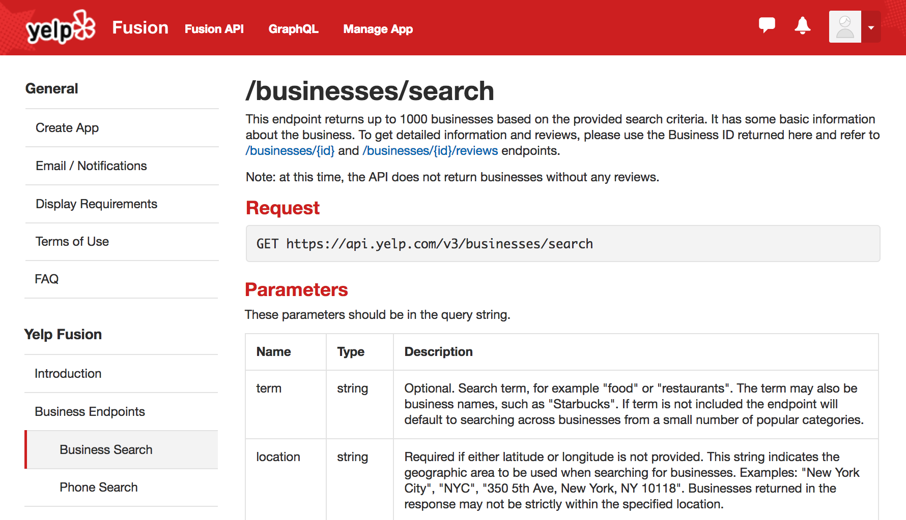
Thank You, Yelp!
Thankfully, we can take advantage of the Yelp Fusion API to programmatically run our queries. (#ThankGoodnessForProgramming)
www.yelp.com

Slide 66
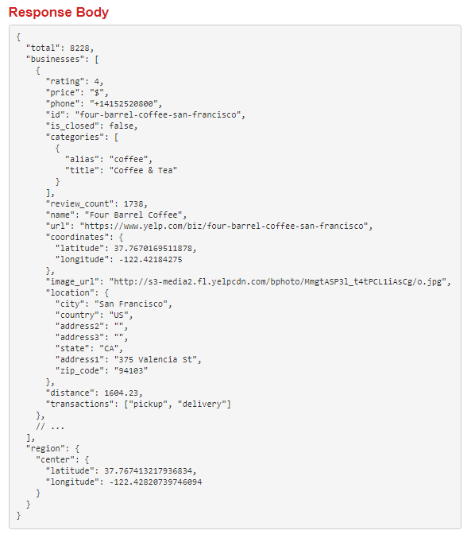

Thank You, Yelp!
www.yelp.com

Slide 67



Step 4: Build Data Retrieval Plan
We will build a Python script to randomly select over 700 zip codes from the U.S. Census, and then acquire review data from the top-20 Mexican and top-20 Italian restaurants for each zip code using the Yelp API.
11101
Italian | Mexican
Restaurant | Restaurant
Restaurant | Restaurant
Restaurant | Restaurant
Restaurant | Restaurant
Restaurant | Restaurant
07360
Italian | Mexican
Restaurant | Restaurant
Restaurant | Restaurant
Restaurant | Restaurant
Restaurant | Restaurant
Restaurant | Restaurant
20001
Italian | Mexican
Restaurant | Restaurant
Restaurant | Restaurant
Restaurant | Restaurant
Restaurant | Restaurant
Restaurant | Restaurant
68007
Italian | Mexican
Restaurant | Restaurant
Restaurant | Restaurant
Restaurant | Restaurant
Restaurant | Restaurant
Restaurant | Restaurant
22434
Italian | Mexican
Restaurant | Restaurant
Restaurant | Restaurant
Restaurant | Restaurant
Restaurant | Restaurant
Restaurant | Restaurant
30301
Italian | Mexican
Restaurant | Restaurant
Restaurant | Restaurant
Restaurant | Restaurant
Restaurant | Restaurant
Restaurant | Restaurant
www.yelp.com

Slide 68
Step 5: Retrieve the Data

Slide 69
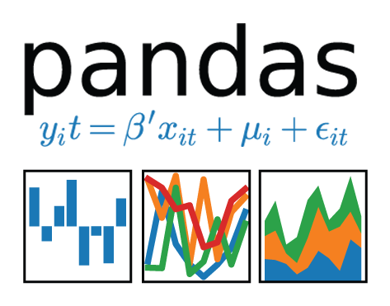
Pulling with Python
Randomly Select a Zip Code
Save the Output to a DataFrame
Create an API Request

Slide 70
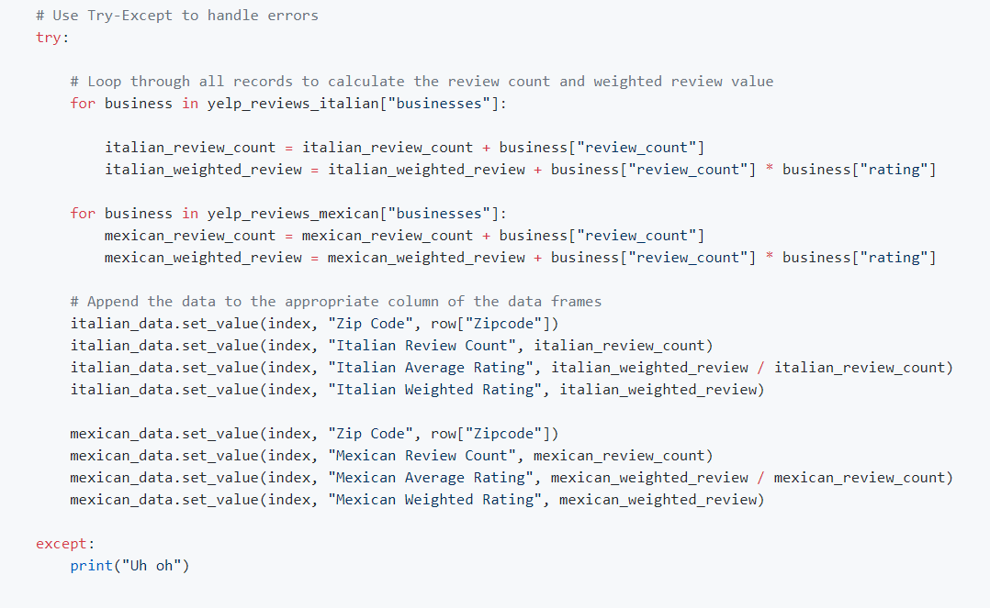
Pulling with Python
This funky code...

Slide 71
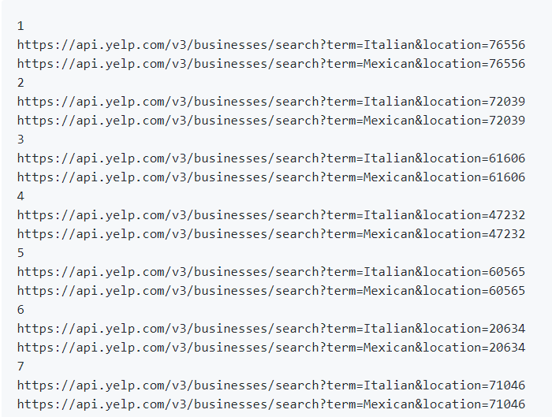
Pulling with Python
...will make all of these URLs.

Slide 72
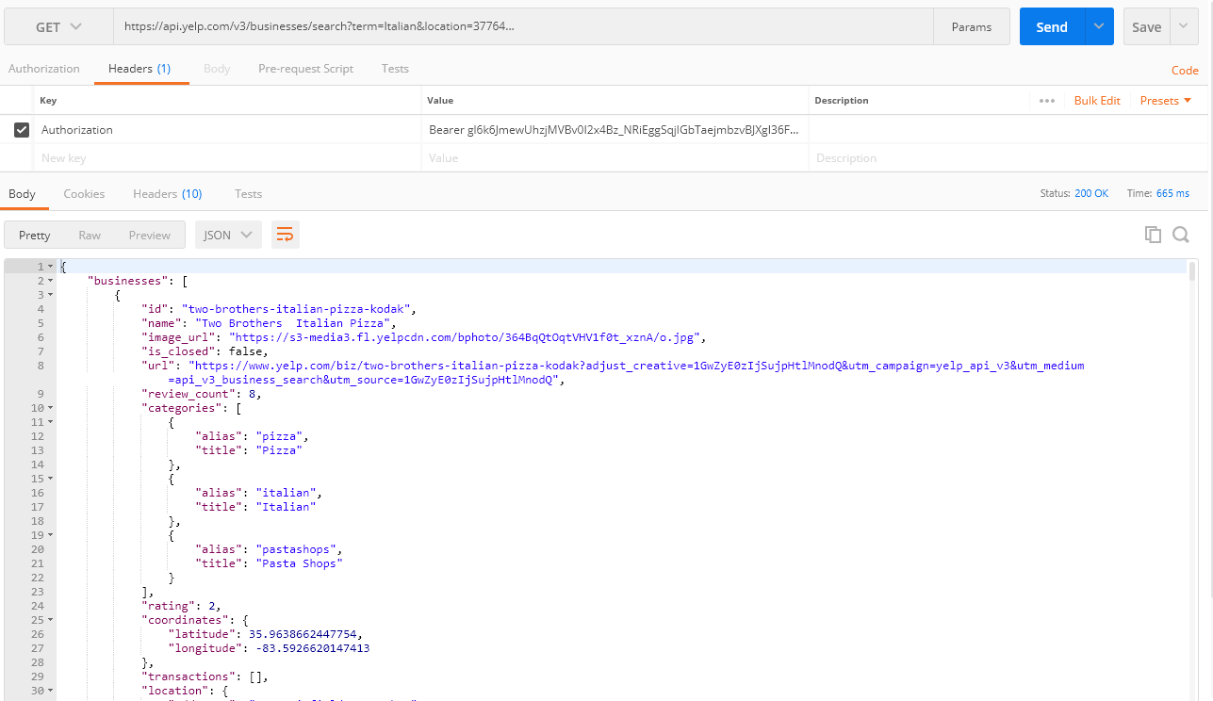
Pulling with Python
Each of these URLs holds a piece of our answer.

Slide 73
Step 6: Assemble and Clean the Data

Slide 74
Cleaning with Pandas
No data comes out exactly the way you want it to.
In our case, we needed multiple steps to aggregate the data along our channels of interest.
# Combine DataFrames into a single DataFrame combined_data = pd.merge(mexican_data, italian_data, on=”Zip Code”) combined_data.head( )
 | Zip Code | Mexican Review Count | Mexican Average Rating | Mexican Weighted Rating | Italian Review Count | Italian Average Rating | Italian Weighted Rating
0 | 76556 | 97 | 4.1134 | 399 | 63 | 3.78571 | 238.5
1 | 72039 | 256 | 4.11133 | 1052.2 | 266 | 3.81955 | 1016
2 | 61606 | 378 | 3.64286 | 1377 | 66 | 3.2197 | 212.5
3 | 47232 | 222 | 4.16892 | 925.5 | 420 | 3.77857 | 1587
4 | 60565 | 2842 | 3.94053 | 11199 | 2829 | 3.92824 | 11113

Slide 75
Step 7: Analyze for Trends

Slide 76
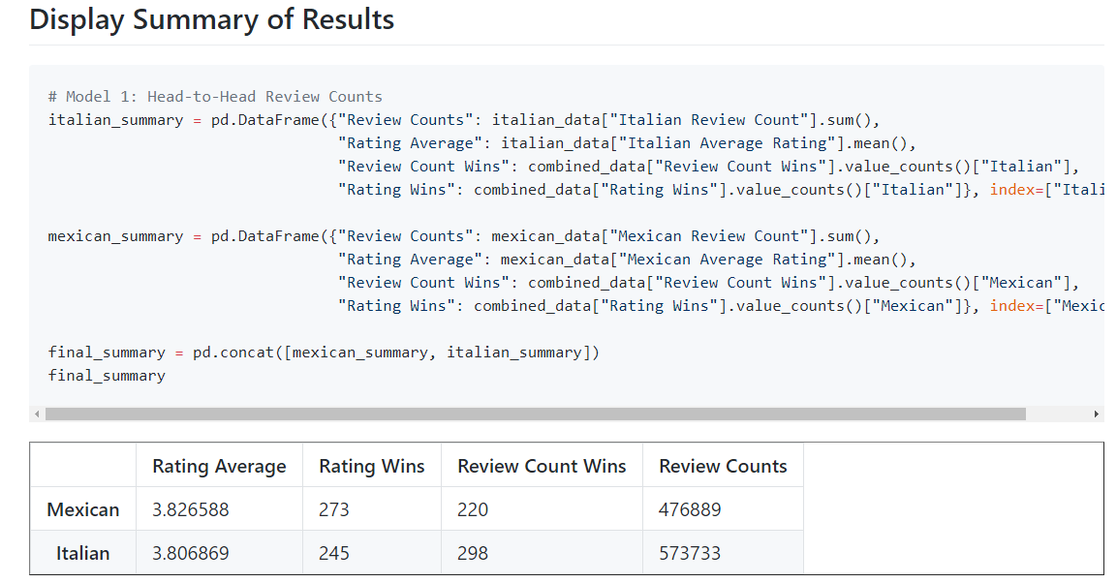
Analyze for Trends (Table)
It’s close:

Slide 77
Analyze for Trends (Ratings)
Yelpers rate Italian and Mexican relatively equally.
4.0
3.5
3.0
2.5
2.0
1.5
1.0
0.5
0.0 | Mexican | Italian
Yelp Ratings by Food Variety
=
Average Rating
Food Variety
www.yelp.com

Slide 78
Analyze for Trends (Ratings)
Yelpers seem to review significantly more Italian restaurants.
Yelp Ratings by Food Variety
600000
500000
400000
300000
200000
100000
0.0 | Mexican | Italian
Review Counts
Food Variety
www.yelp.com

Slide 79
Analyze for Trends (Statistical Analysis)
We have an intuitive sense that the numbers are close, but to quantify our intuition, we use a Student's t-test. After performing the t-test, we can quantifiably state that the differences are not statistically significant
Metric | Italian | Mexican | p-value (t-test)
Average Rating | 3.806 | 3.826 | 0.284
Review Counts | 573k | 476k | 0.057
The difference in review count is not statistically significant.

Slide 80
Analyze for Trends (Winner Take All)
Just for fun, let’s throw in an analysis that aggregates the data from all cities using a winner-take-all approach.
It’s sort of a wash.
 | # of Cities with Preference by Food Variety According to Rating
300
250
200
150
100
50
0 | Mexican | Italian
 | Food Variety
 | # of Cities with Preference by Food Variety According to Review Counts
300
250
200
150
100
50
0 | Mexican | Italian
 | Food Variety
# of Cities
# of Cities
www.yelp.com

Slide 81
Step 8: Acknowledge Limitations

Slide 82
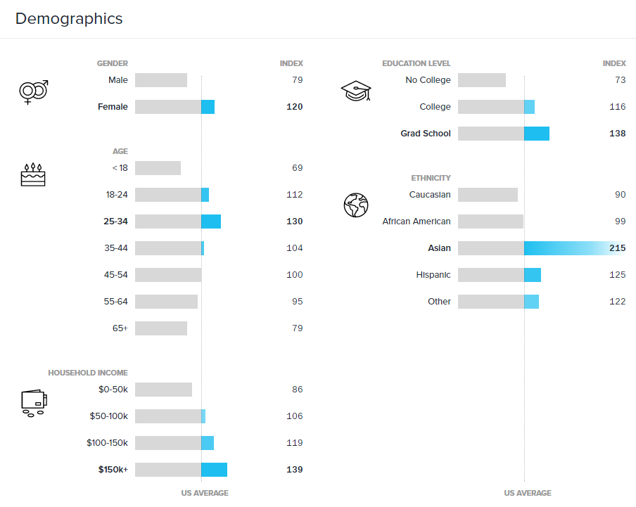
Limitations of Analysis
Yelp demographics may not match the American demographic.
www.yelp.com

Slide 83


Limitations of Analysis
Restaurant experiences do not equate to home-cooked meals.

Slide 84

Limitations of Analysis
Fine-dining effect?

Slide 85
Step 9: Make the Call

Slide 86
Making the Call
The “Proper” Conclusion:
Based on our analysis, it’s clear that Americans’ preferences for Italian and Mexican food are similar in nature. As a whole, Americans rate Mexican and Italian restaurants at statistically similar scores (avg. score: 3.8, p-value: 0.285). However, there is substantial evidence that Americans write more reviews of Italian restaurants than Mexican restaurants (+96k, p-value: 0.057).
This may indicate there is an increased interest in visiting Italian restaurants “for the experience.” Or it may merely suggest that Yelp users enjoy writing reviews of Italian restaurants more than Mexican restaurants.

Slide 87
Making the Call
The “Let’s Be Real” Conclusion: Italian (but it’s going to be close).

Slide 88
An Analytics Paradigm

Slide 89
Analytics Paradigm
Regardless of type or industry, this paradigm provides a repeatable pathway for effective data problem-solving.
Vestibulum congue tempus
Decompose the Ask
Identify Data Sources
Define Strategy and Metrics
Assemble and Clean
Retrieve the Data
Build Data Retrieval Plan
Analyze for Trends
Acknowledge Limitations
Make the Call or Tell the Story

Slide 90
Group Activity: Predicting Gentrification
Using the analytics paradigm as a framework, outline a strategy to identify which neighborhoods in our city are seeing signs of gentrification.
15 minutes

Slide 91
Group Activity: Predicting Gentrification
Specifically, how would you answer these questions:
Pay special attention to details like:
What observable signs can we detect to suggest gentrification is happening?
What means can we use to determine how long the trend has been happening?
What proxies might we use to identify gentrification in non-obvious ways?
How might you create a visualization of this data to best “tell the story”?
What data will you use to build your model?
How will you retrieve the data?
What does your final “story” look like?

Slide 93
Prepare for Next Class
By next class:
01
Make certain that you have Microsoft Excel installed.
02
Make certain that you have Slack installed and your are actively checking it.
03
Figure out where the Git repository for our class is.
04
Figure out where class videos will be posted.

